Slide 1
Prophecy, End Times, Blessed Hope
Journey Evangelical Church
December 5, 2021
HANDOUT

Slide 2
The Bible: One Complete Story
One-third of the Bible is prophetic in nature.
Jesus returning soon!

Slide 3
What is Bible Prophecy?
God revealing history in advance through a person - 2 Peter 1:19-21
Prove God’s Word is true - Deut 18:18,22
Displays God’s character and nature - Isaiah 42:8-9

Slide 4
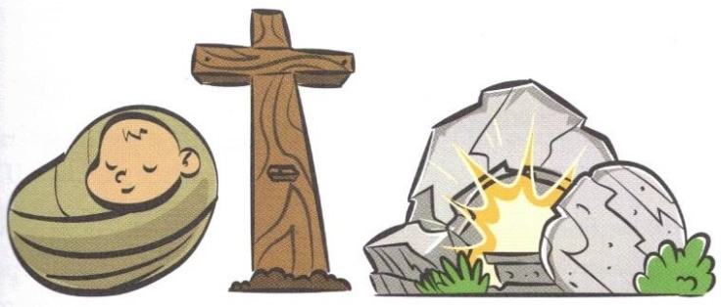
Christian Worldview
A Christian apologetic (explanation, defense)
Every philosophy has to answer the same questions
How did it all begin? Creation
What went wrong? Fall
What can we do about it? Redemption

Slide 5
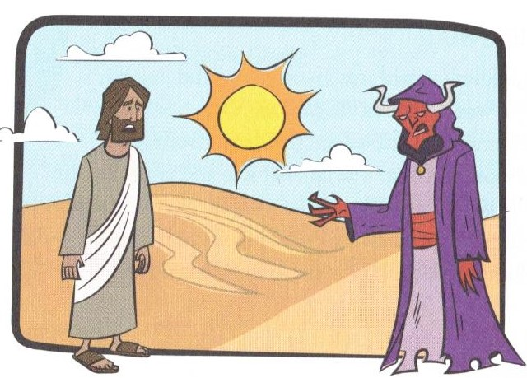
Jesus Christ: Truth
Jesus answered, “I am the way and the truth and the life. No one comes to the Father except through me.
John 14:6
If you hold to my teaching, you are really my disciples. Then you will know the truth, and the truth will set you free. John 8:31-32

Slide 6
Devil: Deceiver
You (the Jews who had believed) belong to your father, the devil, and you want to carry out your father’s desire. He was a murderer from the beginning, not holding to the truth, for there is not truth in him. When he lies, he speaks his native language, for he is a liar and the father of lies. John 8:44

Slide 7
The End Times
1st Coming of Christ – First Advent
The Rapture
The Tribulation
2nd Coming of Christ
The Millennium

Slide 8
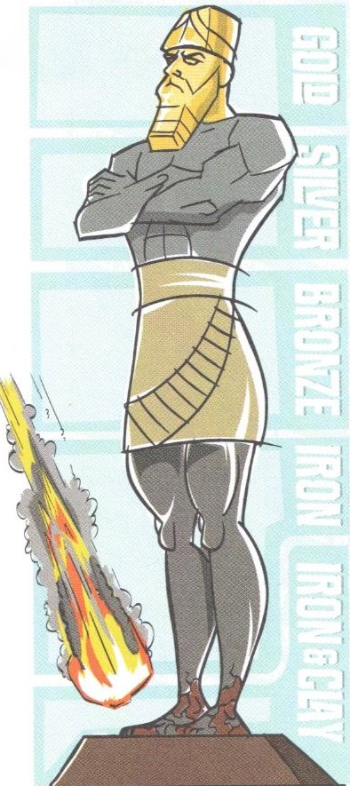
Signs of the Present Times!
1. Geopolitical Signs
2. Signs of Nature
3. Spiritual Signs
4. Signs of Culture
5. Signs of Technology
Sign of Convergence

Slide 9
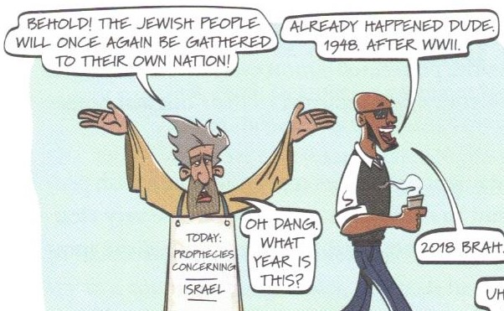
Israel Is the Super Sign
No other end-time signs until Israel reestablished as nation again
Jeremiah 16:14-15

Slide 10
… while we wait for the blessed hope – the glorious appearing of our great God and Savior, Jesus Christ
Titus 2:13

Slide 11
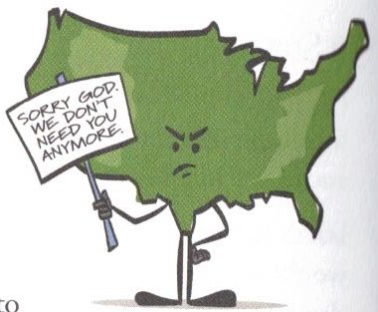
How Shall We Now Live?
Eternity in view!
1. Are you walking with God?
2. What is your vision for JourneyEC?
3. How are you bringing in God’s kingdom?

Slide 12
Search the Scriptures
The Daily Light Devotional Bible (ESV)
The Non-Prophet’s Guide to the End Times; Todd Hampson
Total Truth; Nancy Pearcey
www.Christianbook.com (1-800-247-4784)

